Slide 1
Welcome To
SIG
PizzaMania

Slide 2
Methodology
Define the objectives Create an ER diagram Generate synthetic data Perform exploratory data analysis Design and develop the dashboard Test and deploy the dashboard

Slide 3
Objectives
To Find out amount of revenue and profit generated by each outlet
Understand popular pizza flavors
Evaluate current staffing levels and assess workload distribution across different outlets.
Increasing the sales

Slide 4
ER Diagram
The relationships between the tables are as follows:
A customer can place one or more orders.
An order can have one or more pizzas.
An order can have one delivery.
A shop can have one or more employees.

Slide 5
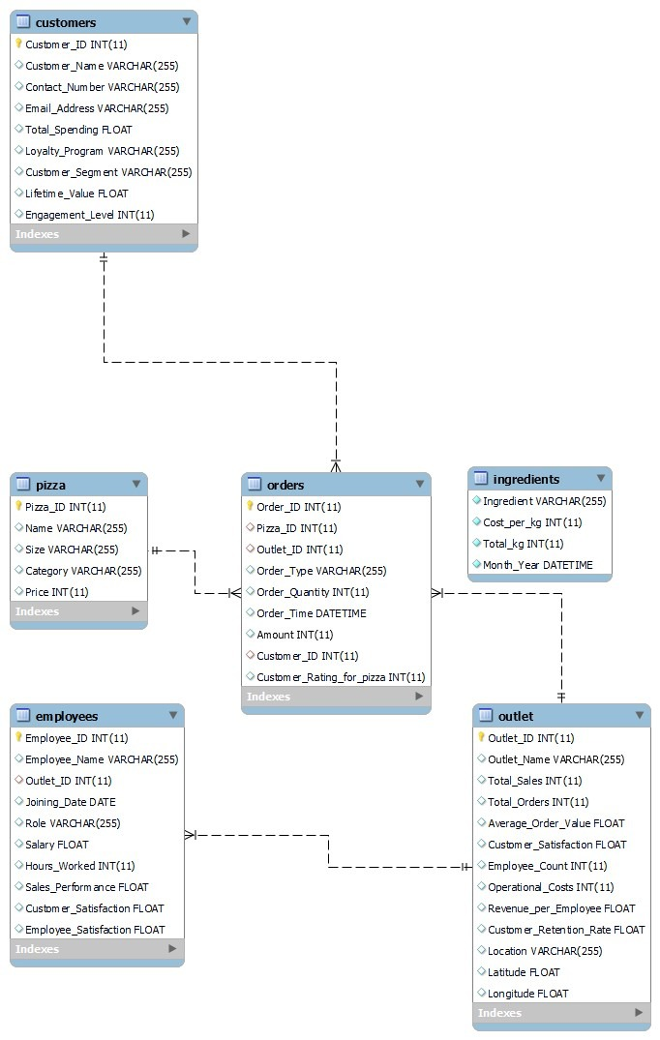

Slide 6
Data Generation

Slide 7
Data Generation
To develop Python scripts to simulate real-world scenarios and generate comprehensive datasets that accurately represent various aspects of the pizza sales process, including customer orders, sales transactions, and inventory management.
To Implement data generation logic that accounts for diverse factors such as customer preferences, seasonal variations, and promotional activities, to create a rich and dynamic dataset for comprehensive analysis.
To Integrate data validation checks within the code to ensure the generated data adheres to predefined constraints and accurately reflects the operational environment of the pizza business.
To Incorporate randomization techniques and statistical distributions to mimic realistic fluctuations in demand, customer behavior, and market trends, thereby creating a robust and representative dataset for thorough analysis.
Utilizing appropriate libraries and frameworks in Python to efficiently handle large-scale data generation, enabling the creation of sizable datasets that capture the intricacies of the pizza sales process in a computationally efficient manner.

Slide 8
ETL
Extract
Transform
Load
The process of extracting data from various sources
Transforming it to fit operational needs
Loading it into a target database or data warehouse.

Slide 9
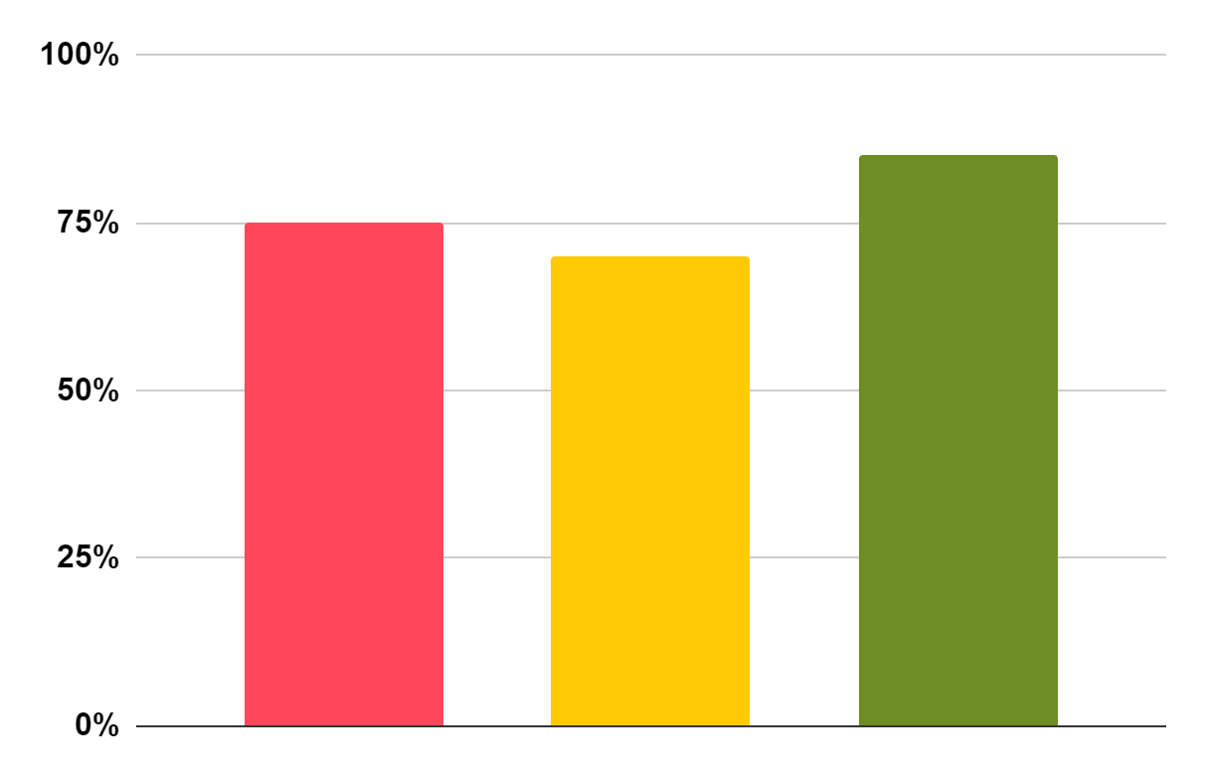
Dashboards
Sales Analysis
Profit Analysis
Customer Segments

Slide 10
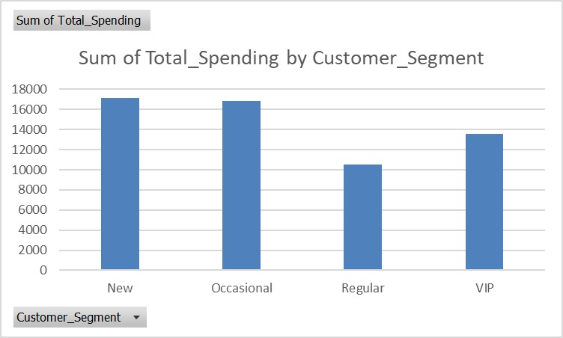
Total Spending by Customer Segment
New and occasional customers are generating maximum revenue.

Slide 11
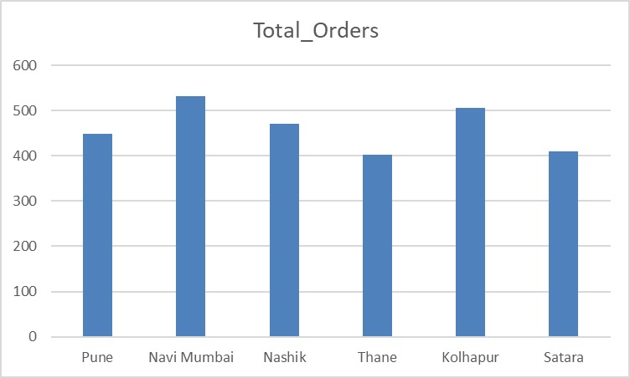
Total Orders
Navi Mumbai and Kolhapur outlets are getting the most amount of orders. Employees at each outlet should be well trained and delivery services should be efficient so that the customer is satisfied.

Slide 12
Profit
$302,000
Total Profit Till Date
80%

Slide 13
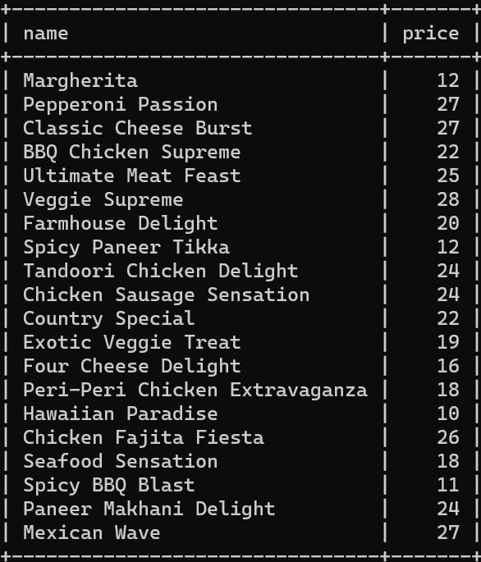
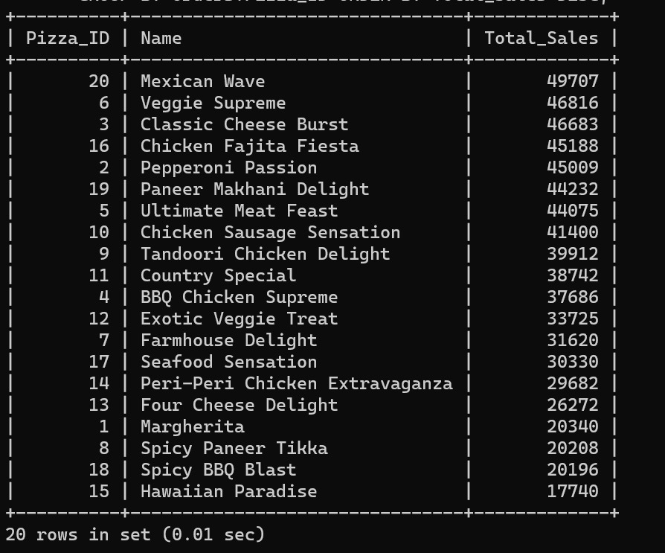
Most revenue Generating Pizza

Slide 14
Conclusion
Most orders are placed during quarter 1 and 4
The number of orders is high during festive seasons
The order is given as Medium ‘M' size pizza at most.
Paneer Makhani Delight is generally preferred pizza.
Mexican green wave was highest revenue generating pizza

Slide 15
710 K
Big numbers catch your audience’s attention

Slide 16
Solutions
Leverage the success of Navi Mumbai and Kolhapur outlets by introducing regional specialties to further boost sales.
Prioritize comprehensive training for employees and optimize delivery services to enhance overall customer satisfaction and retention.
Tailor specific offers for underperforming segments to expand the customer base and improve overall sales performance.
Emulate the operational strategy of the Thane outlet, which demonstrates the highest sales and profit figures, to enhance the performance of other outlets.
Focus on maintaining operational efficiency, staff optimization, and quality assurance to ensure sustainable growth and customer-centric service across all outlets.

Slide 17
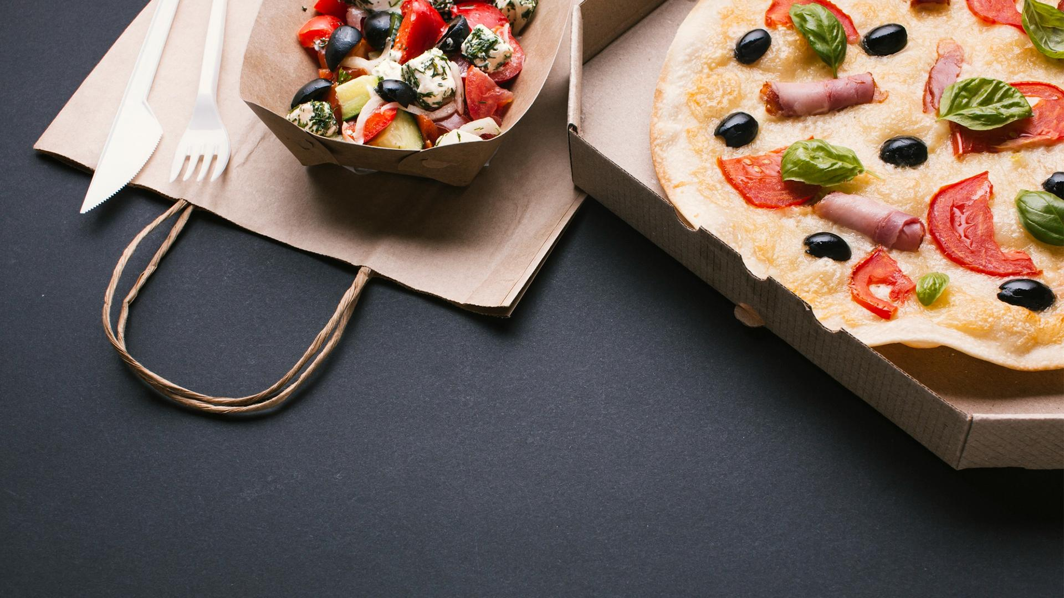
Thank You!

Slide 18
ICON PACK: FOOD DELIVERY
Here’s an assortment of alternative resources whose style fits the one of this template:

